Slide 1
Queue List Service
Technical - Overview
Integration Team
February 2018

Slide 2
AGENDA
Overview
Web services
Samples

Slide 3
“
GPP-SP allows users to manage payments by exposing SOA services. QueueList Service is used to query and retrieve payments from GPP. ”

Slide 4

Queue list SERVICE
This service enables a Third Party Application to search for payments in GPP.
Using this service user can search both active payments as well as archived payments
Appropriate filter criteria have to be provided in the request. List of filter criteria is available in the SOA technical guides.
Processing
The input parameters are validated and a query is build
If ‘queue name’ is defined, the service adds a filtering criteria with that value to the query, and the service adds a criteria for active payments P_IS_HISTORY =0 to the query, as default. See Service Functions to learn more about other processing scenarios.
The response is sent.

Slide 5
Filter criteria
The filtering criteria may consist of one or more conditions with the following structure:
Define the condition number (cond lineNumber) starting with zero, then define the first field or function to match with (leftVal) where the CT (i.e. criterion) may be ‘Field’ or ‘Function’, then the CT value (value) specifying a logical field ID, the logical field ID must come between quotation marks.
Define the second field or function to match with (rightVal) where the CT (i.e. criterion) may be ‘Field’, ‘Function’ or ‘InList’ and value is the value to compare to. The value must come between quotation marks.

Slide 6
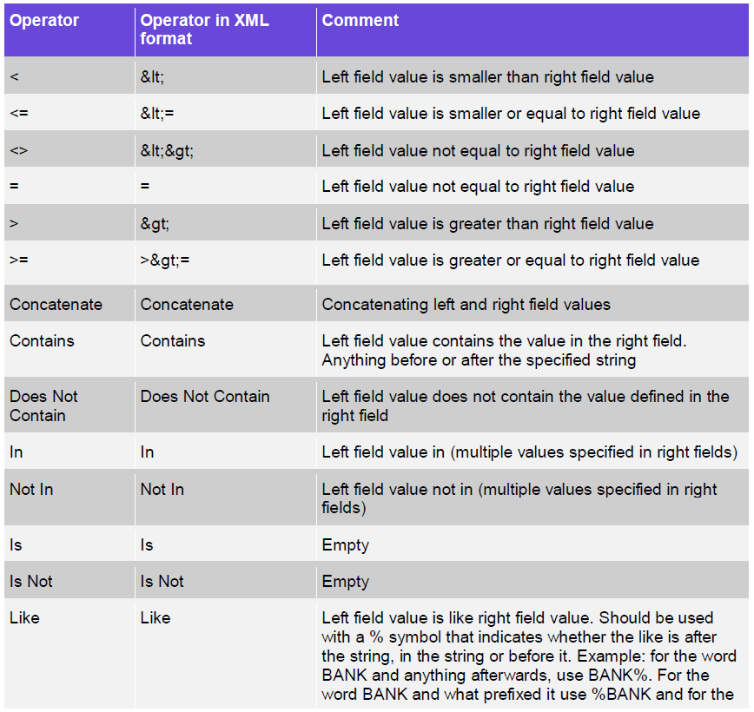
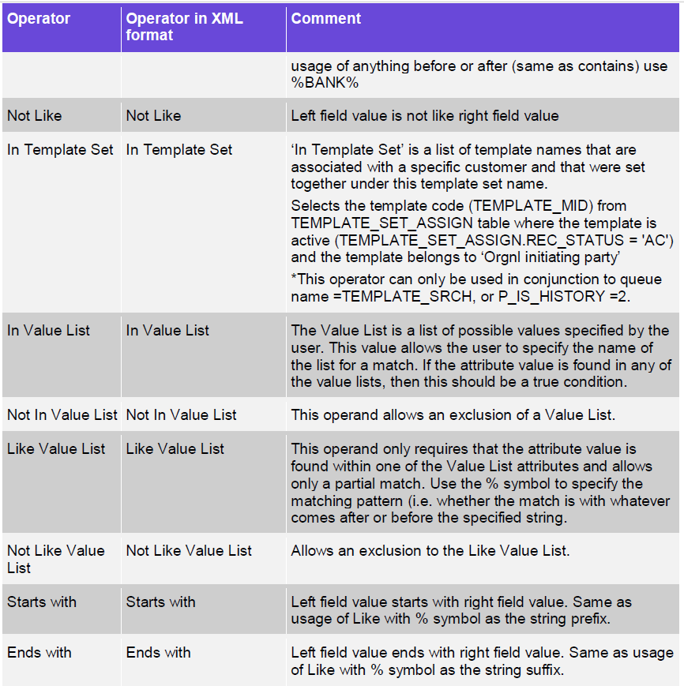
operators

Slide 7
Samples
Request | Response

Slide 8
Thank you
Arnab Podder
Integration Team
alexander.perman@finastra.com

